Slide 1


Bitcoin price forecasting
Big Data Computing Project
A.Y. 2022 - 2023
Faculty of Ingegneria dell'informazione, informatica e statistica
Department of Informatica
Danilo Corsi
Matr. 1742375
Notes:
Good evening, I’m Danilo and for this final project I’ve decided to build a Bitcoin price forecasting model in order to see if it possible to make predictions about the price of Bitcoin using machine learning methods

Slide 2

Outline
Introduction
What is bitcoin?
Goal of the project
Notes:
I will first introduce what bitcoin is and what is the aim of this project

Slide 3

Outline
Introduction
What is bitcoin?
Goal of the project
Dataset and features
Data collection
Features engineering
Notes:
Next we will see what data will be used and how to achieve the goal

Slide 4
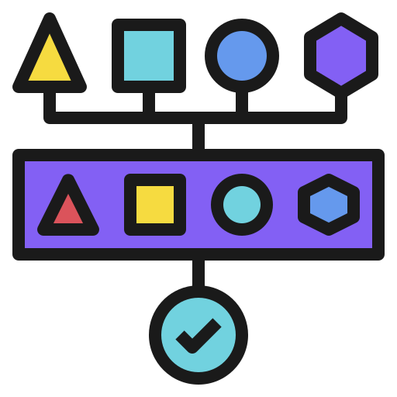
Outline
Introduction
What is bitcoin?
Goal of the project
Dataset and features
Data collection
Features engineering
Project pipeline
Data crawling / feature extraction
Models train / validation
Final scores
Notes:
Followed by a description of the main stages of the project

Slide 5

Outline
Introduction
What is bitcoin?
Goal of the project
Dataset and features
Data collection
Features engineering
Project pipeline
Data crawling / feature extraction
Models train / validation
Final scores
Conclusions
Notes:
And draw the final conclusions

Slide 6


Introduction
What is Bitcoin?
Decentralized cryptocurrency
No central bank behind it
Relies on a network of nodes
Transactions
Uses strong cryptography (validity and security)
Made by anyone with a Bitcoin address
Public ledger constantly updated
Notes:
Let's start by explain briefly what Bitcoin is
Bitcoin is a decentralized cryptocurrency, created in 2009 by an anonymous inventor under the pseudonym of Satoshi Nakamoto
It does not have a central bank behind it but relies on a network of nodes that manage it in a distributed, peer-to-peer mode
It uses strong cryptography to validate and secure transactions and these can be made through the Internet by anyone with a bitcoin address
These are stored in a public ledger which is constantly updated and validated by nodes in the network

Slide 7
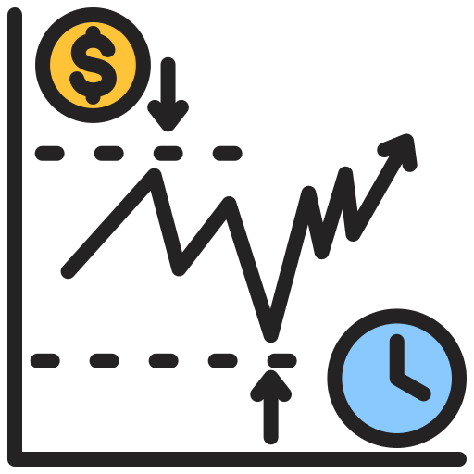
Introduction
What is Bitcoin?
Decentralized cryptocurrency
No central bank behind it
Relies on a network of nodes
Transactions
Uses strong cryptography (validity and security)
Made by anyone with a Bitcoin address
Public ledger constantly updated
Value determined by the market and the number of people using it
Price fluctuation can be extremely unpredictable
Prediction of Bitcoin prices can be a competitive advantage
Notes:
It’s value is determined by the market and the number of people using it
This cryptocurrency has attracted the attention of many people in recent years, however, the price fluctuation can be extremely unpredictable
In this context, predicting Bitcoin prices can be a competitive advantage for investors and traders, as it could allow them to make informed decisions on the right time to enter or exit the market

Slide 8

Goal
Analyze machine learning techniques
Understand how accurately the price of Bitcoin can be predicted
Can provide added value to cryptocurrency investors and traders?
Notes:
The main goal of this project was to analyze some machine learning techniques to understand, through the processing of historical data, how accurately the price of Bitcoin can be predicted and whether this can provide added value to cryptocurrency investors and traders

Slide 9




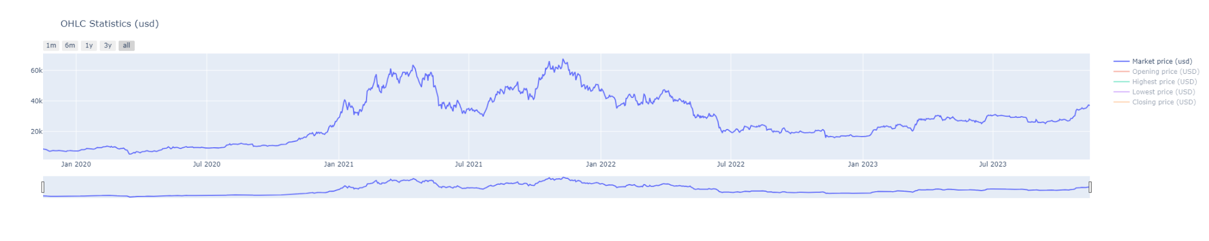
Dataset and features
Collecting Bitcoin data:
Blockchain.org (for blockchain data)
Binance and Kraken exchanges (for price information)
Data organized in 15-minute time-frame
Retrieving the most relevant information from the last four years to current days
Lateralization
High volatility
Notes:
I collected Bitcoin blockchain data using the API of the Blockchain.org website and price information from two popular exchanges, Binance and Kraken,
I decided to organize them in 15-minute time-frame and I’ve retrieved the most relevant data from the last four years to current days, a period on which there were moments of high volatility but also some price lateralization

Slide 10
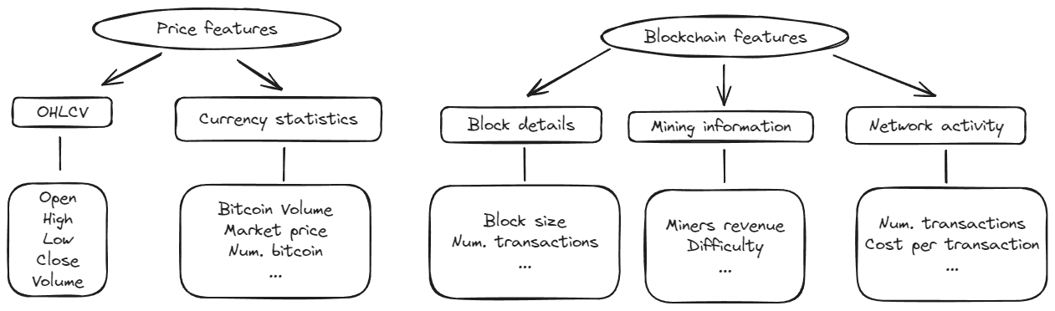
Dataset and features
Collecting Bitcoin data:
Blockchain.org (for blockchain data)
Binance and Kraken exchanges (for price information)
Data organized in 15-minute time-frame
Retrieving the most relevant information from the last four years to current days
Notes:
The features taken under consideration were divided into several categories, from those that describe the price characteristics to those that goes into more detail about Bitcoin's blockchain

Slide 11




Project pipeline
Structure:
Data crawling / Feature engineering: retrieve and process data
Models’ train / validation: different models and splitting methods
Final scores: collect results and draw conclusions
Project carried out with Apache Spark (during some phases I converted the Spark dataframe to a Pandas one to make some plots)
Notes:
The project pipeline is the following
First, I retrieved all the data and processed them in order to decide how to use the features
Then the models are trained using different methods of splitting the dataset, which we will see later
And then the final results are collected and conclusions are drawn
The project was carried out with Apache Spark but during some phases I converted the Spark dataframe to a Pandas one to make some plots

Slide 12
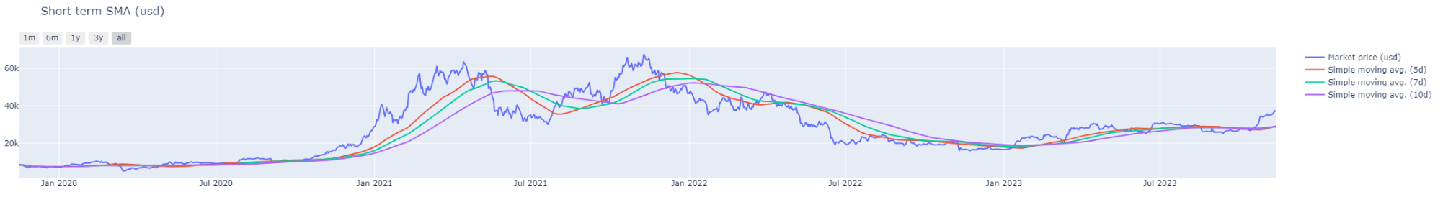
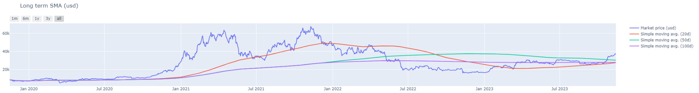
1 - Data crawling / Feature engineering: features
Additional features
Next market price: next-15 minutes Bitcoin price (will be the target variable)
Simple moving avg: average price over a specified number of days
Notes:
Starting from the first phase, after obtaining all the data, other features were added
Such as next-market-price that represents the price of Bitcoin for the next 15 minutes, on which predictions will be made
And some simple moving averages indicators that calculate the average price over a specified number of days

Slide 13
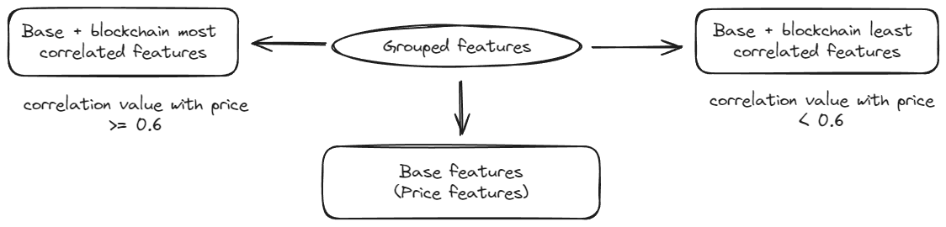
1 - Data crawling / Feature engineering: features
Additional features
Next market price: next-15 minutes Bitcoin price (will be the target variable)
Simple moving avg: average price over a specified number of days
Notes:
Then all the features have been divided into three distinct groups
Base features that contains all the price related features
And those that contains the previous ones plus the additional blockchain features divided based on their correlation value with the price
If this value is greater than or equal to 0.6 they will be considered most correlated, least correlated otherwise

Slide 14
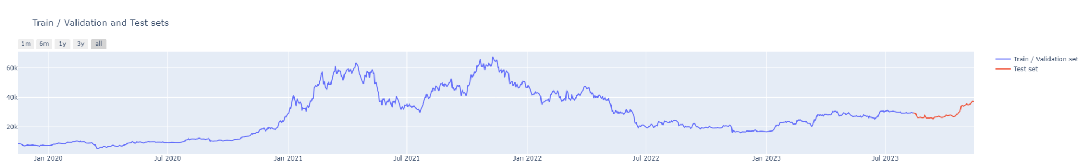
1 - Data crawling / Feature engineering: splitting
Two sets:
Train / Validation set: used to train and validate models
Test set: used to perform price prediction on never-before-seen data (last 3 months of the original dataset will be used)
Notes:
Then the whole dataset will be splitted into two sets
A Train / Validation one that will be used to train the models and validate the performances
And a Test one that will be used to perform price prediction on never-before-seen data, in our case the last 3 months of the original dataset will be taken into consideration

Slide 15
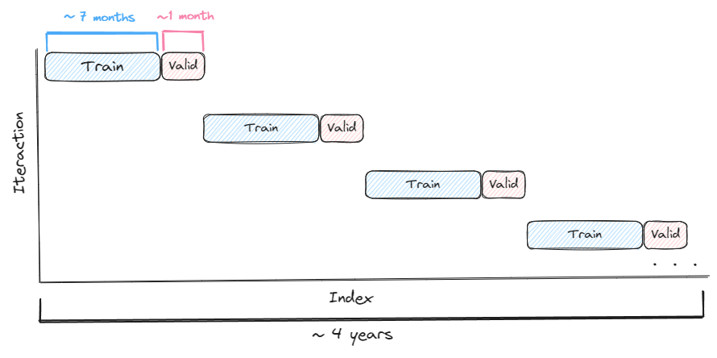
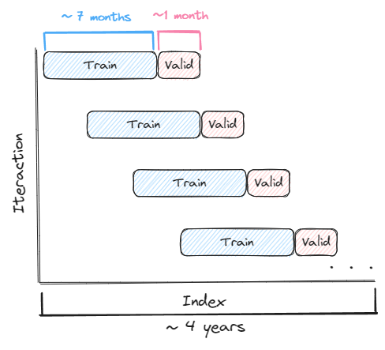
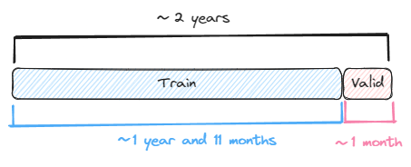
2 - Models train / validation: splitting methods
Block Splits
Walk Forward Splits
Single split
Notes:
These are the different splitting methods used to train and validate the models in order to figure out which one works best for this task
Block splits involves dividing the time series into blocks of equal length
Walk forward uses a sliding window approach to create the training and validation sets
Single split divides the entire time series into just two splits considering a narrow period of time

Slide 16

2 - Models train / validation: splitting methods
Block Splits
Walk Forward Splits
Single split
Notes:
In fact, in the latter case I consider only 2 years instead of 4 as in the others, to best benefit from the trend in the short term

Slide 17


2 - Models train / validation: models and metrics
ML models:
Linear Regression
Generalized Linear Regression
Random Forest Regressor
Gradient Boosting Tree Regressor
Metrics:
RMSE (Root Mean Squared Error)
MSE (Mean Squared Error)
MAE (Mean Absolute Error)
MAPE (Mean Absolute Percentage Error)
R2 (R-squared)
Adjusted R2
Notes:
Several types of regression algorithms between linear and tree-based will be tested to see their differences using the following types of metrics to obtain a complete picture of the performance

Slide 18
2 - Models train / validation: accuracy
“How good the models are at predicting whether the price will go up or down?”
Notes:
Since predicting the price accurately is very difficult, I tried to quantify how good the models are at predicting whether the price will go up or down

Slide 19
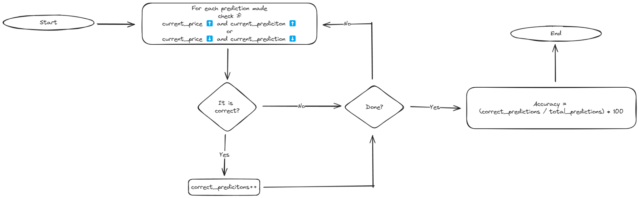
2 - Models train / validation: accuracy
“How good the models are at predicting whether the price will go up or down?”
Notes:
For each prediction that will be made, I am going to consider it correct if the actual price goes up or down and the predicted one follows that trend, wrong if vice versa
After that I count the number of correct predictions among all of them
And finally I compute the overall percentage of accuracy

Slide 20
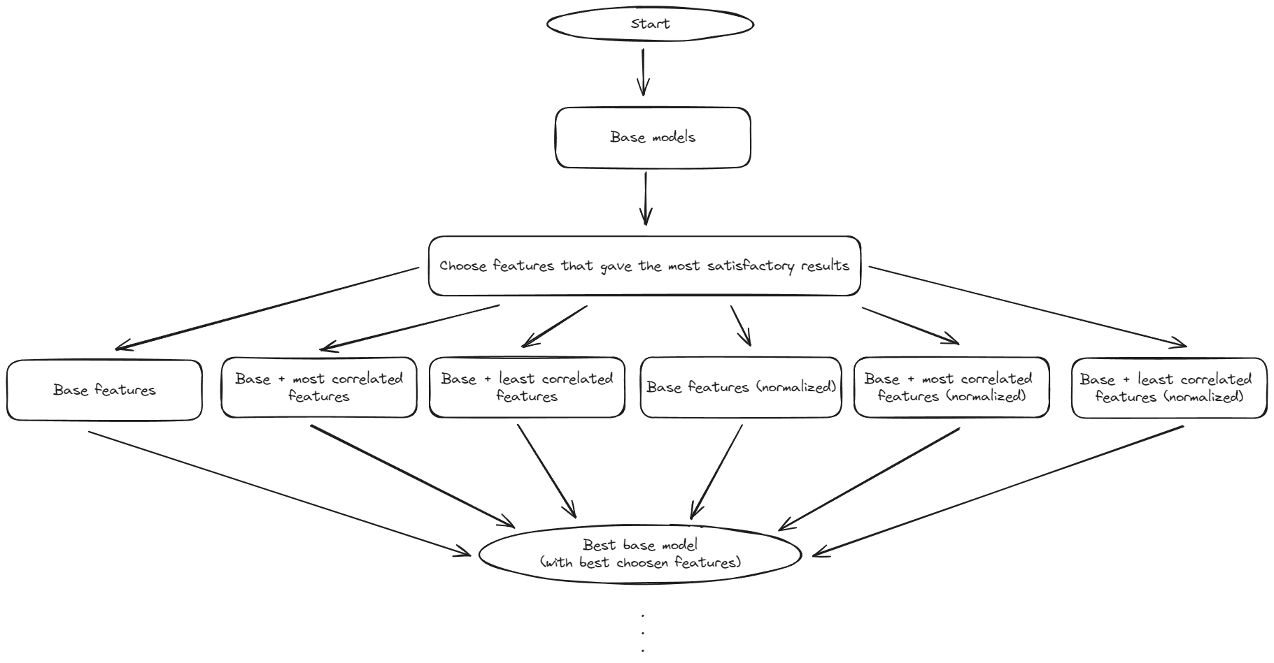

2 - Models train / validation: pipeline
Notes:
The train / validation pipeline is structured like this
First of all, I retrieve the data on how the default models behave with the three feature groups with or without normalization
Then the features that for each model gave the most satisfactory results are chosen and proceed with the next phase which is hyper parameter tuning

Slide 21
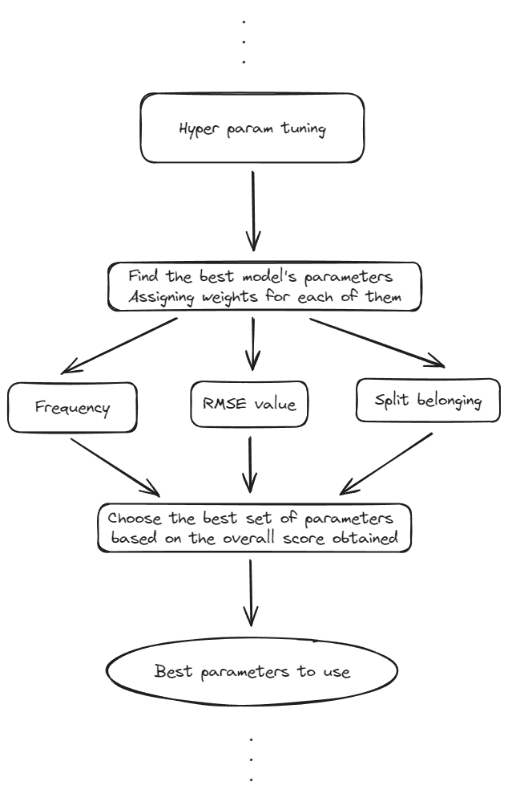



2 - Models train / validation: pipeline
Notes:
Here I will find the best model’s parameters to use

Slide 22
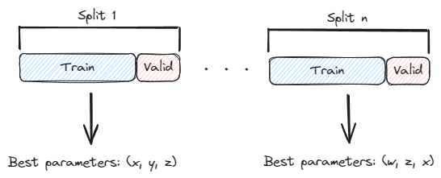
2 - Models train / validation: pipeline
Notes:
Since during this stage will be used the Block or Walk forward splitting method of the dataset I compute a score for each set of parameters chosen by each split, assigning weights based on their frequency of occurrence, split belonging and RMSE value

Slide 23
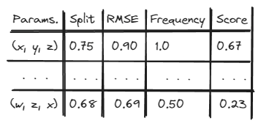
2 - Models train / validation: pipeline
Notes:
Then, the overall score will be calculated by putting together these weights for each set of parameters and the one with the best score will be the chosen one

Slide 24
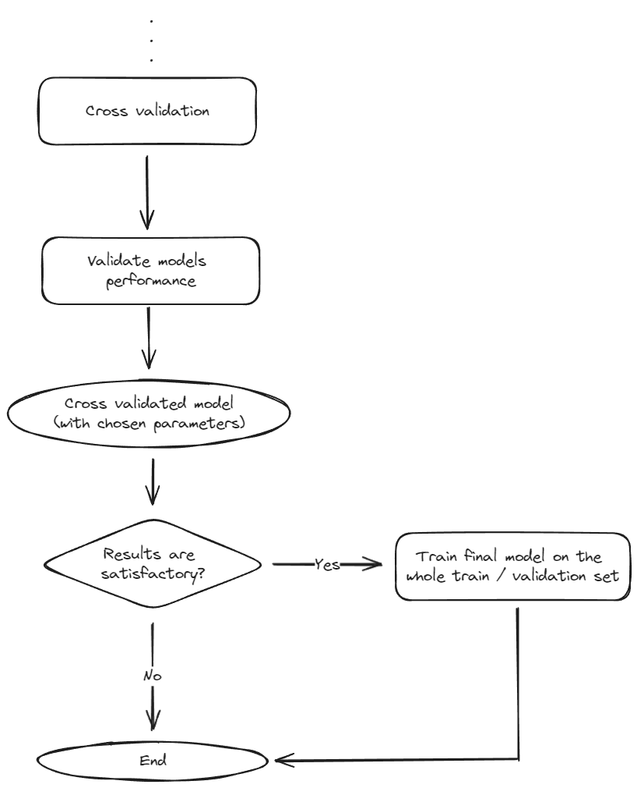

2 - Models train / validation: pipeline
Notes:
After that, the performance of each model is validated by performing cross validation also using here the splitting methods seen previously
And if the final results are satisfactory, the models will be trained on the whole train / validation set and saved in order to make predictions on the test set

Slide 25
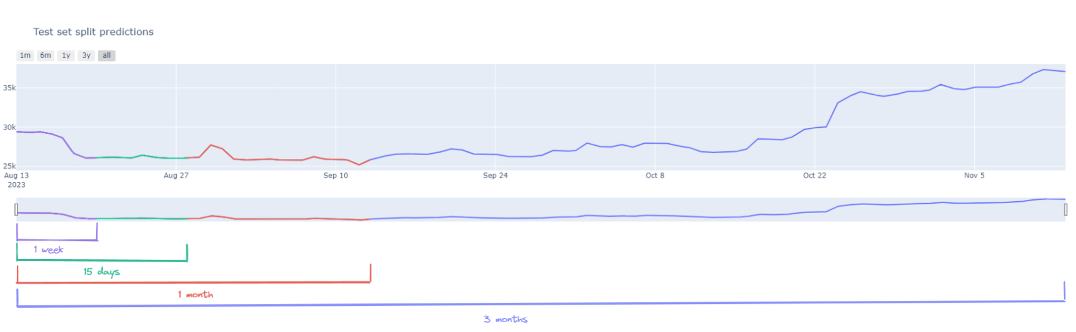

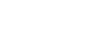
3 - Final scores
Comparison between final results
Prediction on the test set (splitted)
See how models' performance changes as time increases
Notes:
During the final stage all the results obtained up to that point are also compared
Moreover, the test set has been divided into further mini-sets to see how the models performance changes as time increases
Let’s take a look at the most relevant results obtained

Slide 26
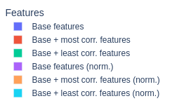
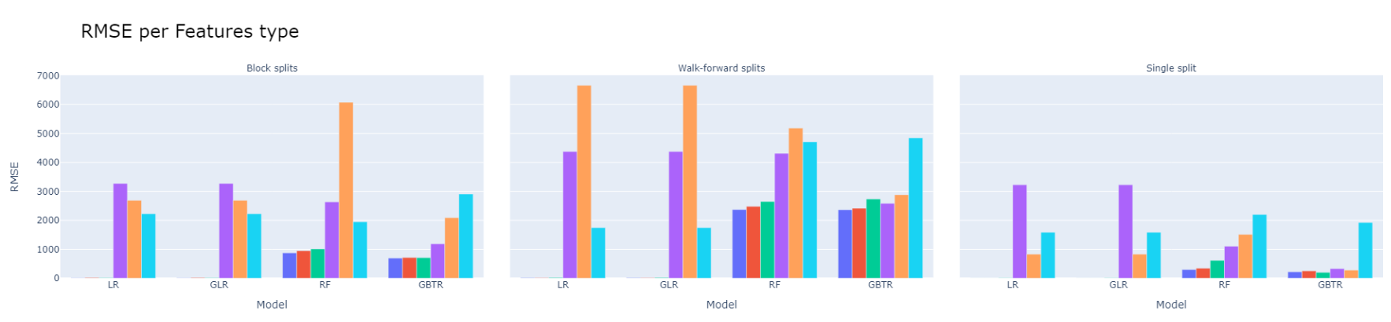

3 - Final scores: train / validation phase
Walk-forward splits return lower performance than Block splits and Single splits
Benefiting from a shorter time horizon
Normalised features produce suboptimal results (high RMSE values)
Benefits varies between models
Notes:
Considering the RMSE values of the default models based on the different splitting methods we can see how the Walk-forward method return lower performance than block and single split, with the latter benefiting from a shorter time horizon
Normalised features produce suboptimal results and their impact varies between models

Slide 27
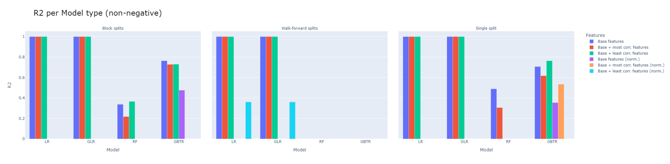
3 - Final scores: train / validation phase
Helps reduce overfitting but presents problems in other scenarios
Blockchain features produces a modest improvements (persistent influence of price-based features)
Notes:
This can best be seen by considering the R2 values where, for example, in linear models overfitting is reduced but still leads to unsatisfactory results to be fully considered
Moreover, the addition of blockchain features produces a modest improvements in some cases, underlining the persistent influence of price-based features

Slide 28
3 - Final scores: train / validation phase
Helps reduce overfitting but presents problems in other scenarios
Blockchain features produces a modest improvements (persistent influence of price-based features)
Chosen features
LR: Base + most corr. (norm.)
GLR: Base + most corr. (norm.)
RF: Base (no norm.)
GBTR: Base + least corr. (no norm.)
Notes:
Considering the results obtained, the features used by the models for the next steps were the following

Slide 29
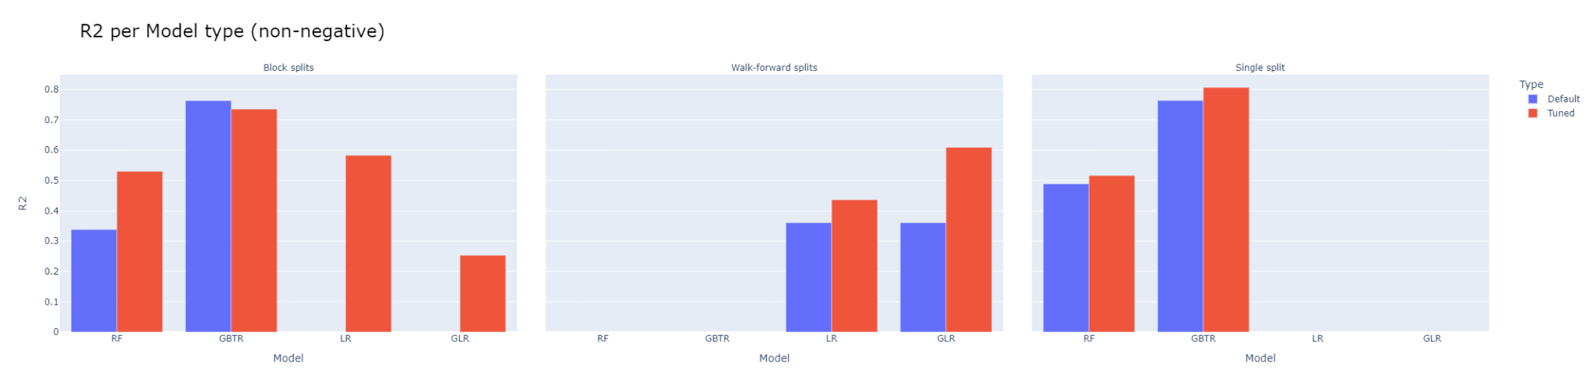
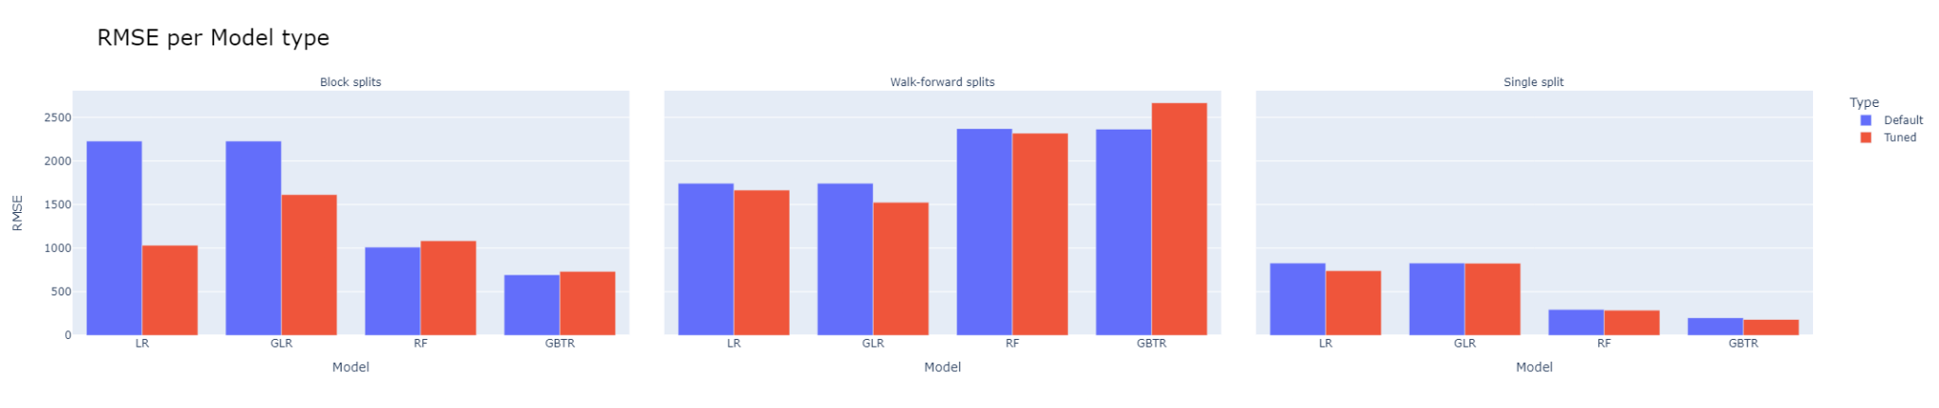
3 - Final scores: train / validation phase
Single split is the best method on which to train / validate the models
Hyper parameter tuning brought some improvements
Tree-based model returned the best results
Notes:
Now let’s see the comparison between the best default model and the model after performing hyperparameter tuning
We can see that the trend regarding splitting methods has remained the same, in fact single split is the best splitting method on which to train / validate the models
In general, hyper parameter tuning brought some improvements compared with the default ones
Moreover, the tree-based models are those that returned the best results

Slide 30
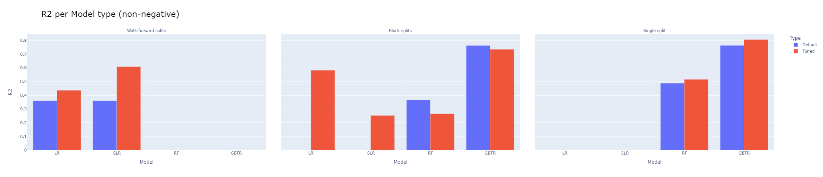
3 - Final scores: train / validation phase
Notes:
This is confirmed by considering the values of R2 where these trends are reflected

Slide 31
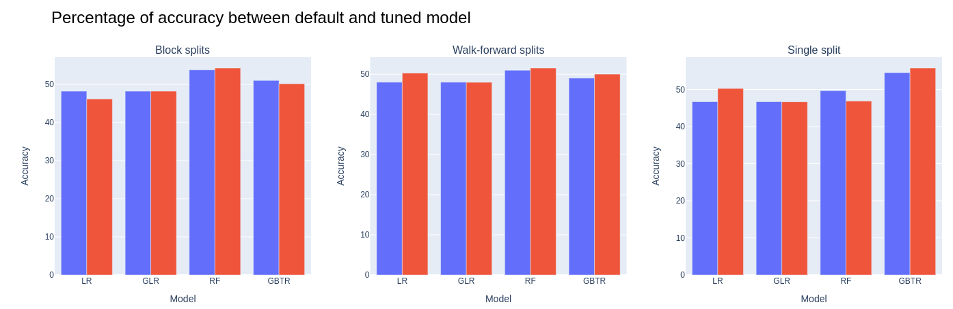
3 - Final scores: train / validation phase
Accuracy has remained the same among (~50%)
Probably due to the period taken into consideration being too long
Notes:
Looking at the accuracy, on the other hand, we can see that this has remained more or less the same for both default and tuned models at around 50%, this may be because the period taken into consideration is too long

Slide 32
3 - Final scores: train / validation phase
Accuracy has remained the same among (~50%)
Probably due to the period taken into consideration being too long
Conclusions
Best splitting method: single split
Best models type: tree-based models
Notes:
In conclusion, regarding this train / validation phase we can say that the best results were obtained using single splitting method and tree-based models

Slide 33
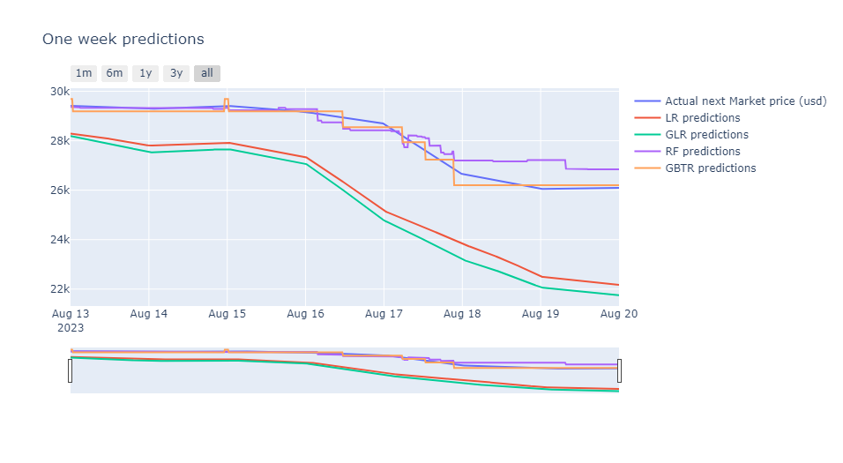
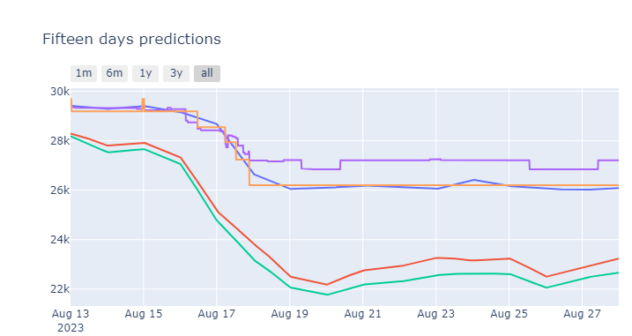
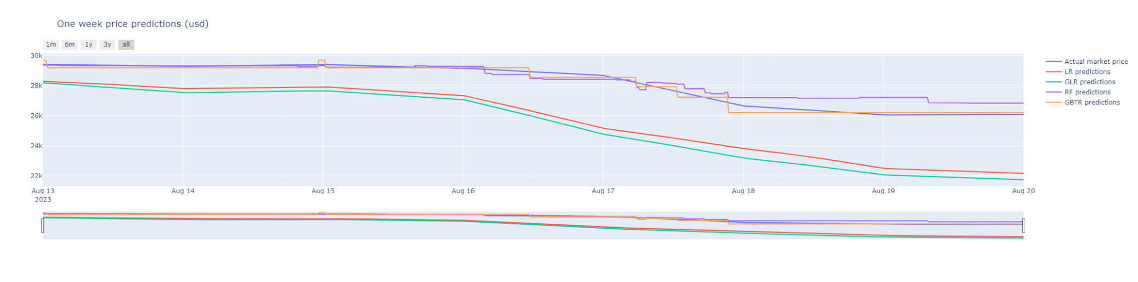
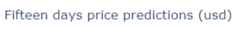

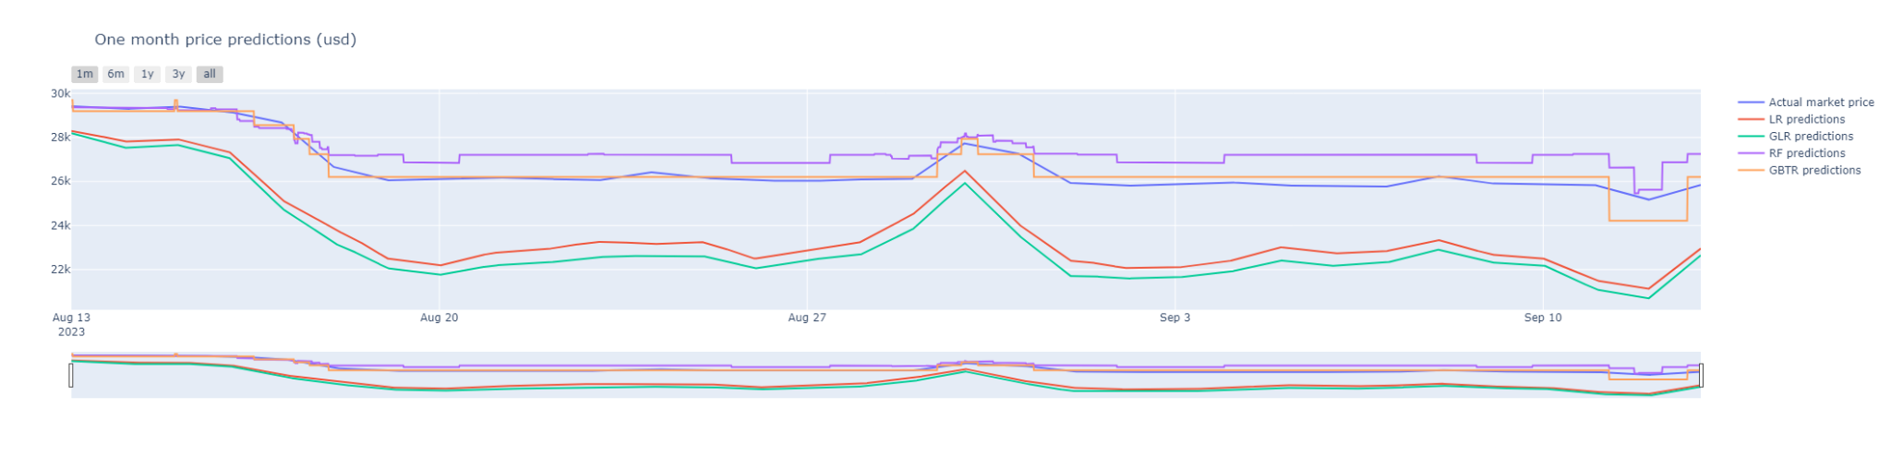
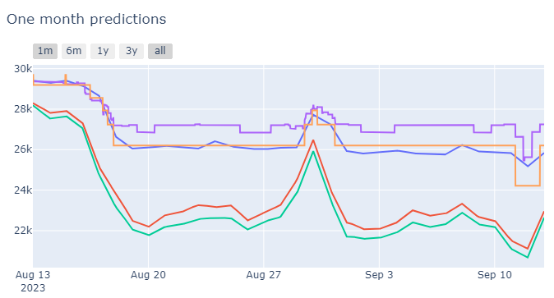
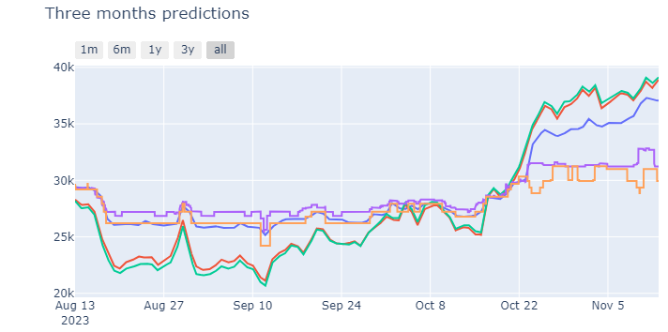
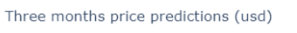
3 - Final scores: testing phase
Short term: [one week, fifteen days]
Short-mid term: [one week, one month]
Long term: three months
Notes:
Moving on to the final predictions made on the test set, we can see that tree-based models perform rather well in the short-mid term period, compared to linear ones

Slide 34

3 - Final scores: testing phase
Short term: [one week, fifteen days]
Short-mid term: [one week, one month]
Long term: three months
Notes:
While in the long term, especially considering the last month, all models failed to capture the price trend well

Slide 35
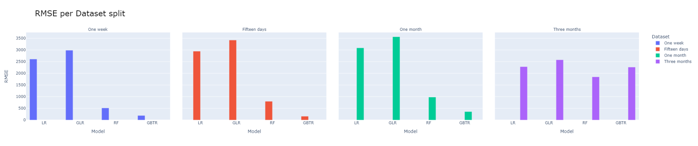
3 - Final scores: testing phase
Short term: [one week, fifteen days]
Short-mid term: [one week, one month]
Long term: three months
As time taken into consideration increase also the RMSE values tends to increase (slowly)
Note
Results were averaged
Having more data at each dataset split
Periods in which the models did better (short-mid term) compensated for the worst results in the last period (long term)
Notes:
Considering the RMSE values, these tends to increase slowly for all models as the time taken into consideration increases
Since the results were averaged and by considering more data at each dataset split, we can see how the periods in which the models did better compensated for the worst results in the last period

Slide 36
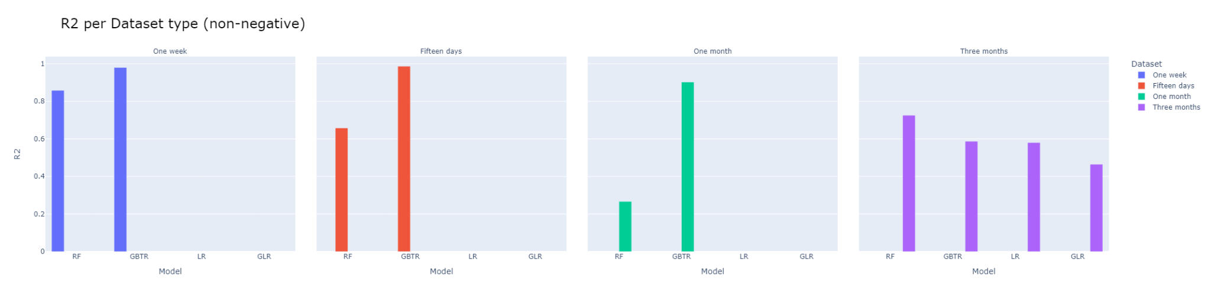
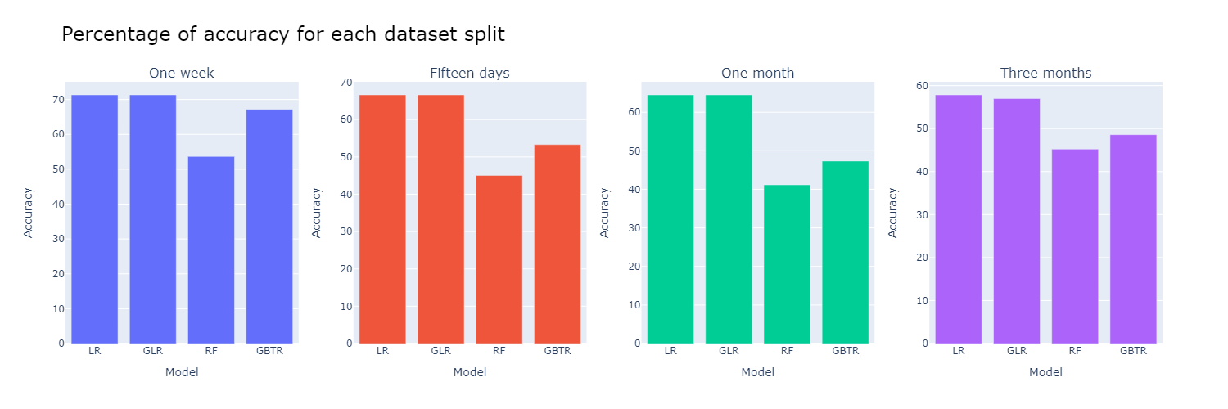
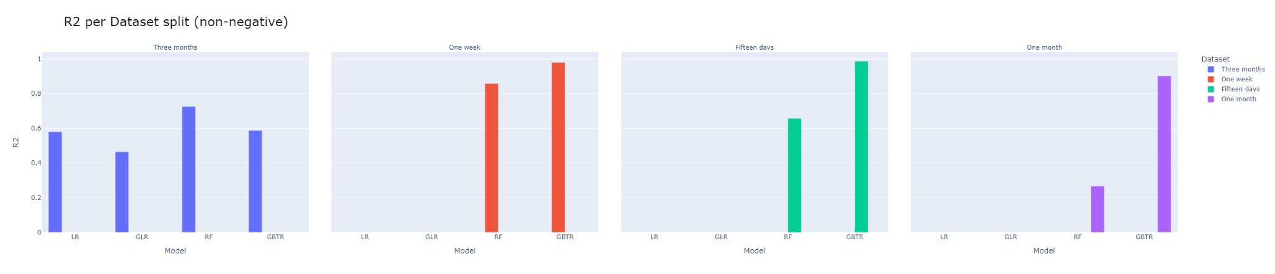
3 - Final scores: testing phase
Short term: [one week, fifteen days]
Short-mid term: [one week, one month]
Long term: three months
Notes:
We see the same trend again in the R2 values

Slide 37
3 - Final scores: testing phase
Short term: [one week, fifteen days]
Short-mid term: [one week, one month]
Long term: three months
Higher in the short-term
Lower in the long-term
Notes:
Regarding the accuracy, this is slightly improved compared to that obtained during the train / validation phase, even reaching 70% in some cases

Slide 38
3 - Final scores: testing phase
Short term: [one week, fifteen days]
Short-mid term: [one week, one month]
Long term: three months
Higher in the short-term
Lower in the long-term
Linear models have a higher accuracy than tree-based models
Probably because because of the smoother curves
Notes:
But it should be noted that in this case linear models have a higher accuracy than tree-based ones, probably because they have smoother curves that allow them to better represent the price rather than tree-based ones that are more jagged

Slide 39
Conclusions
Splitting method
Better those that consider a shorter period (e.g. Single Split)
Features
Depend on the type of model
In general: blockchain-related features brought slight improvements
Models
Better in the short-medium term (especially tree-based models)
As time period increase performance begins to degrade
Notes:
To sum up, we can say that according to these experiments it is better to use a splitting method that considers a narrower time period like single split
With regard to the features used, these depend on the type of model, for example normalisation helped us to reduce overfitting in some cases, but in general the addition of blockchain-related features brought slight improvements
Then with regard to the models, we can say that in the short to medium term, the tree-based ones managed to capture the price trend quite well, but as was to be expected, as the time period increases, performance begins to degrade

Slide 40
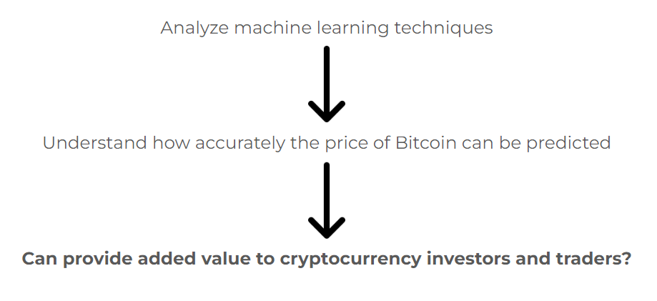
Conclusions
Splitting method
Better those that consider a shorter period (e.g. Single Split)
Features
Depend on the type of model
In general: blockchain-related features brought slight improvements
Models
Better in the short-medium term (especially tree-based models)
As time period increase performance begins to degrade
Answer to the initial question
Yes (as far as the length of the period is concerned)
Better to consider a narrower forecast period for higher accuracy
Future developments
Create a sliding window on features (additional historical data can be used)
Consider events that could influence the price
Using deep learning approaches such as CNNs or Transformers
Notes:
Answering to the initial question we can say that yes, it is at least possible to get an idea of the price trend although we have seen that this is more accurate in the short term
Some future developments could be the implementation of a sliding window on features to use additional historical data or the consideration of events that could influence the price
Even the use of deep learning approaches such as CNNs or Transformer models that exploit self-attention to better capture trends

Slide 41


Thanks for the attention
Danilo Corsi
https://github.com/CorsiDanilo

